Slide 1
PwC Case
Section C A+FOR ALL
Group member: Di Yang, Jing Wang, Kailin Xue, Ruixin Xu

Slide 2




Team members- A+ For All
Ruixin Xu
Accounting
Jing Wang
Accounting
Kailin Xue
Accounting
Di Yang
Accounting

Slide 3
Agenda
Introduction
Vehicle Dimension
Driver Dimension
Location Dimension
Policy Dimension
Summary

Slide 4
Introduction
We analyzed 1,354 claims, 30,000 policies, 43,652 driver / vehicle combinations, 600 city/zip combinations where risks are located and corresponding companies/branches.
Total Loss Ratio = 19%

Slide 5
Vehicle Dimension
Car maker
Car model
Average price

Slide 6
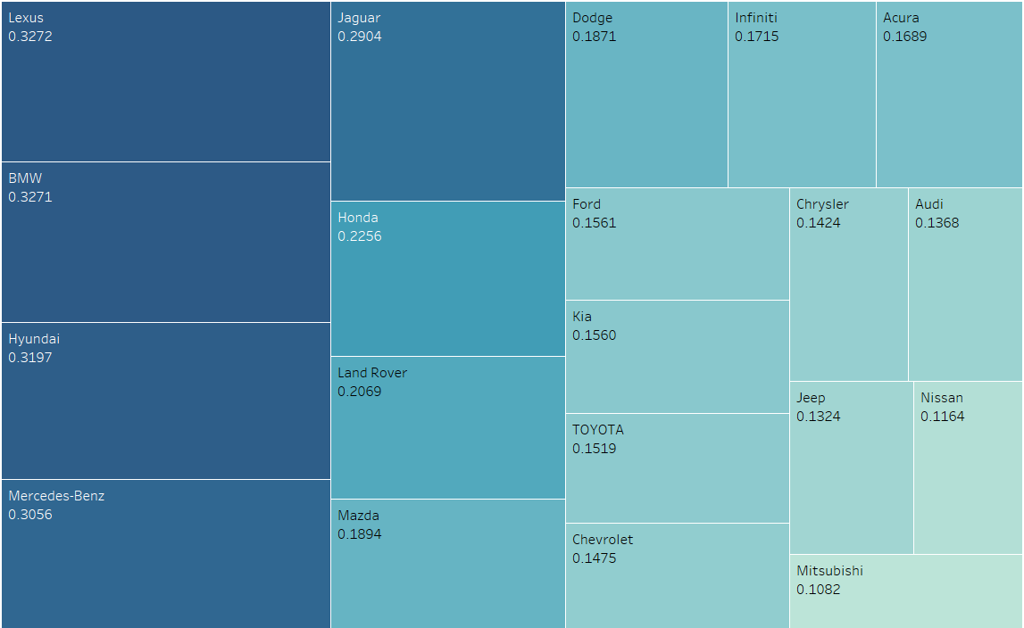
Car Make- loss ratio
Policies on Lexus & BMW vehicles suffers the greatest loss ratio.
The five brands on the left with loss ratio higher than 30%, 50% higher than average loss ratio(18%)
.

Slide 7
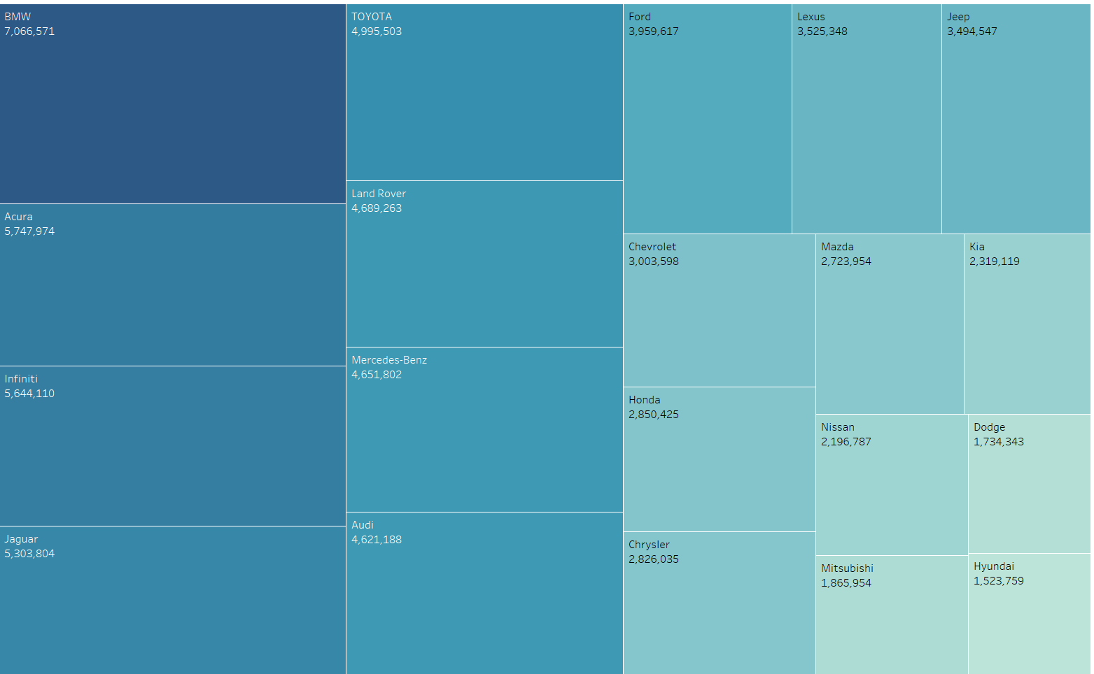
Car Make- Total Premium
BMW related policies receive the most premium, but also the greatest loss.
Acura receives the most premium, and the least loss ratio, which means the policy on Acura is relatively more profitable.

Slide 8
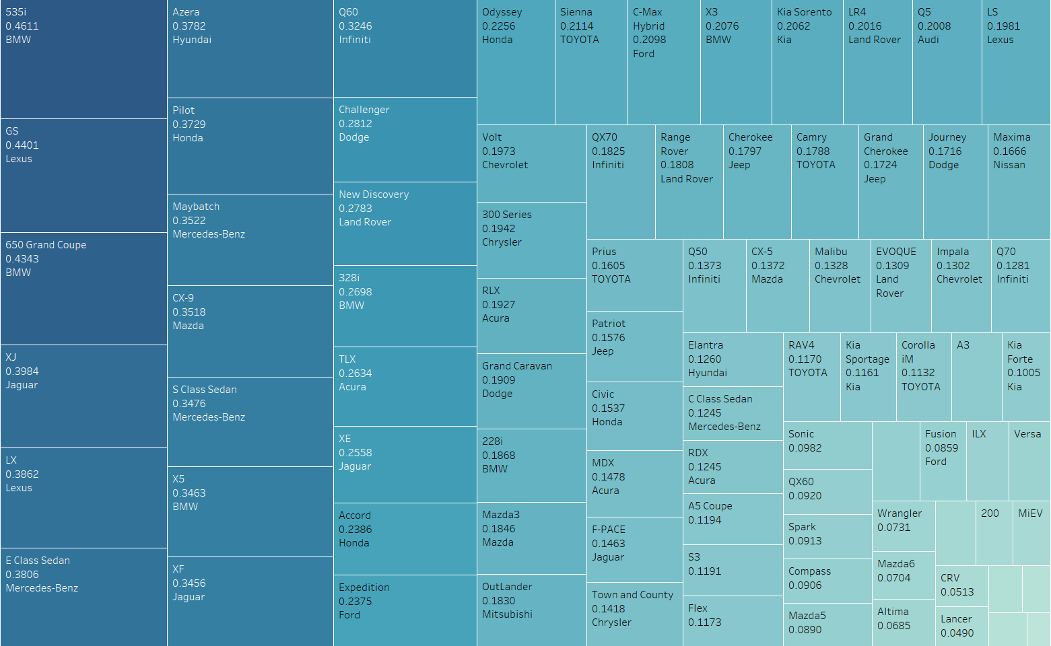
Car Model - Loss Ratio
Policies regarding 535i, GS,650, suffers the most loss ratio (>40%).
All the car model with high loss ratio come from car maker with high loss ratio.

Slide 9
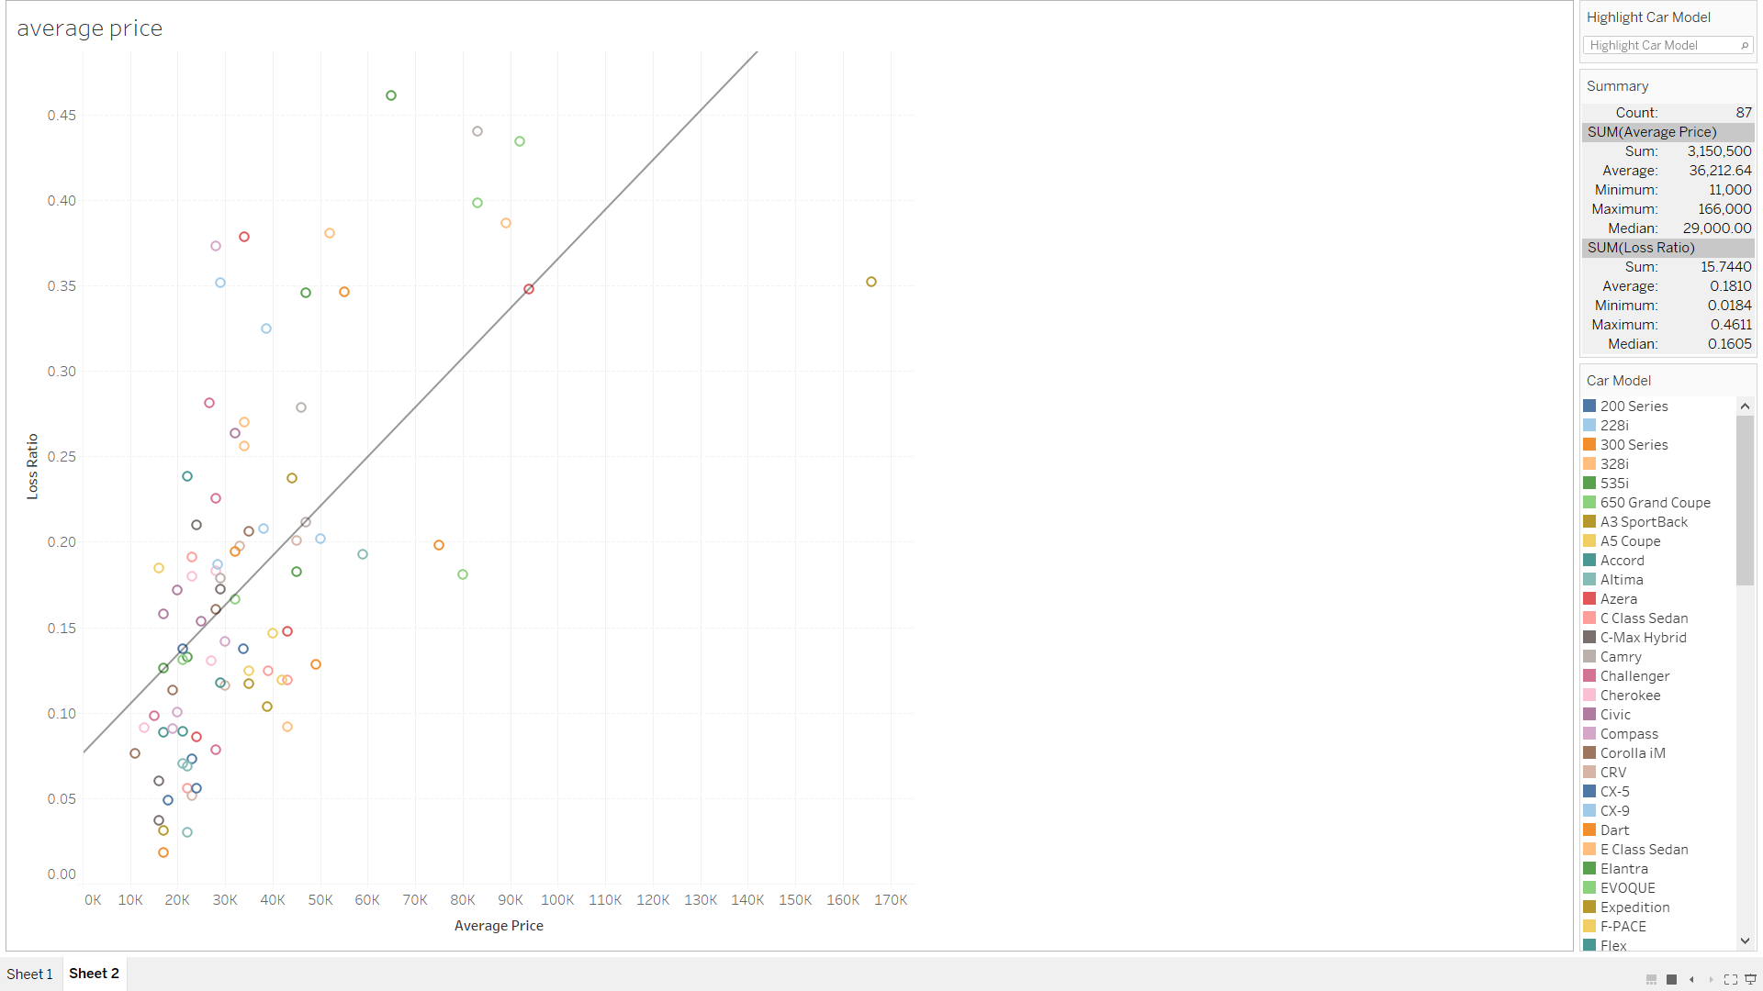
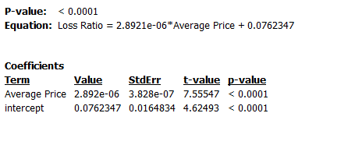
Average price has a significant positive relationship with loss ratio.

Slide 10
Wrap Up & Recommendation
Charge more on Lexus and BMW policy, to avoid high loss ratio.
Seek more contracts with Acura drivers.
Charge more premium when faced with high-loss-ratio car makers.
The higher average price on car, the higher premium to be charged, the less claim amount to pay.

Slide 11
Driver Dimension
Gender
Primary Vehicle Use
Marital Status
Age
Number of Accidents/Violations

Slide 12
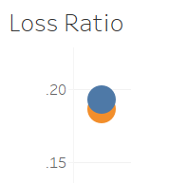

Gender
Blue: M Orange: F

Slide 13
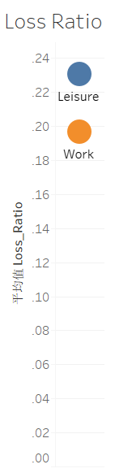
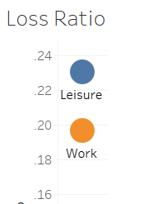
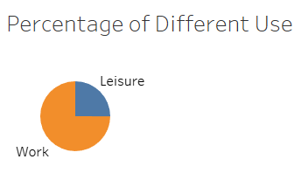
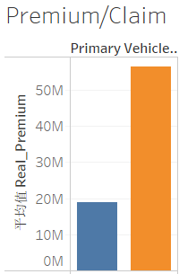
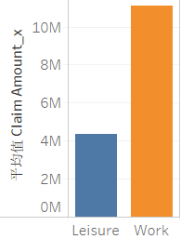

Primary Vehicle Use

Slide 14
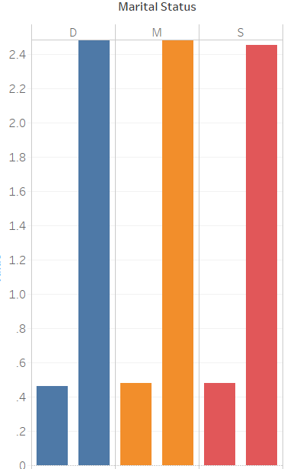
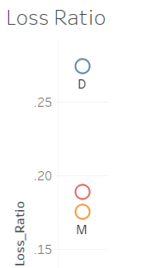
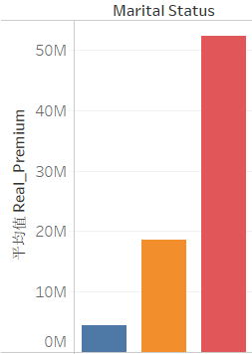
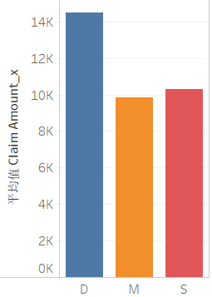
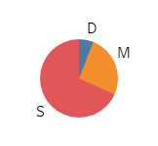
Marital Status
Left: Avg Accidents#
Right: Avg Violations#
Percentage of Different
Marital Status

Slide 15
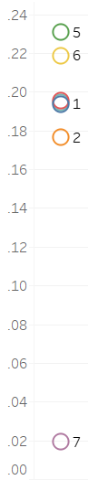
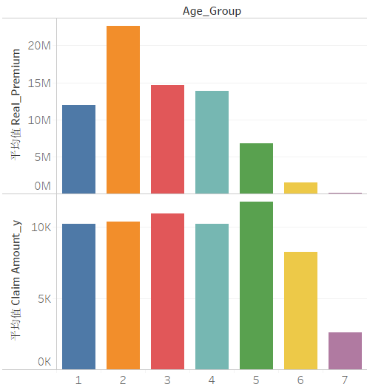
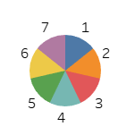
Age
Note: “Age” refers to the age insurers entered into policy
“1” refers to groups that aged between 10-20, and so on
Percentage of Different
Generations
Loss Ratio

Slide 16
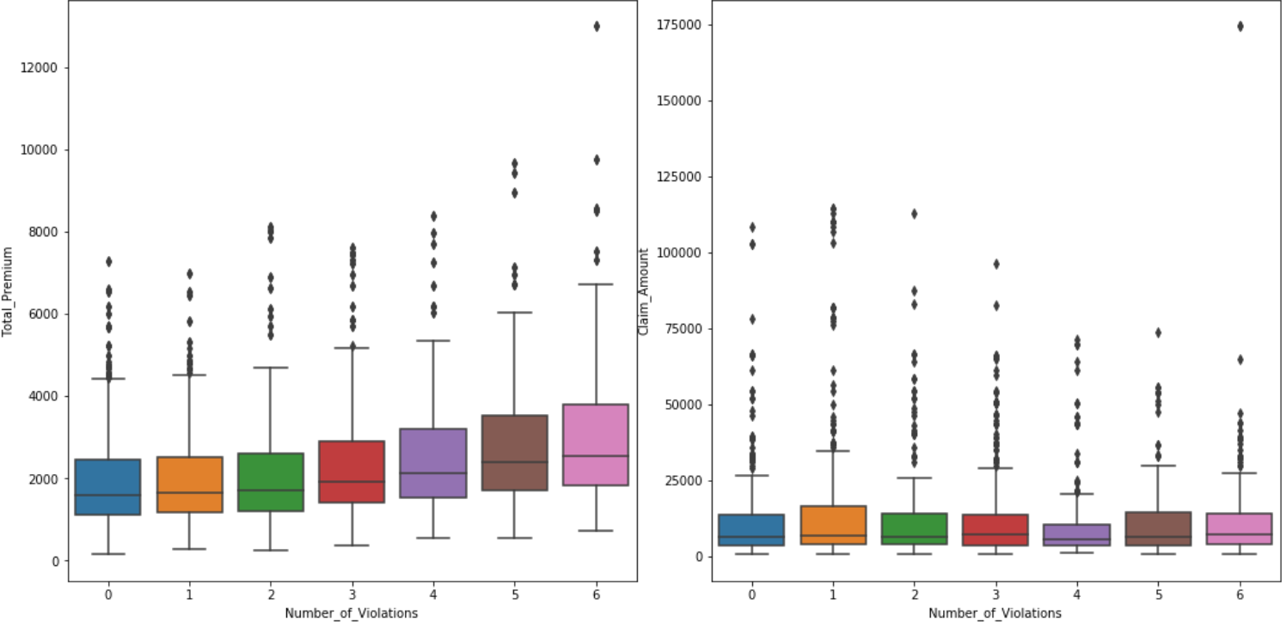
Number of Violations
Total Premium/Claim Amount VS. #Violations

Slide 17
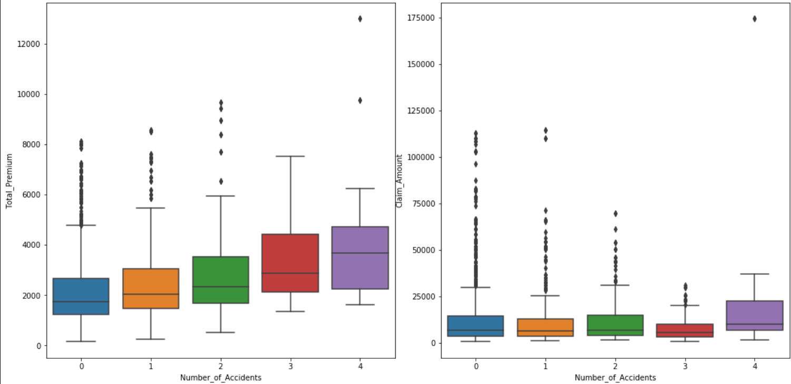
Number of Accidents
Total Premium/Claim Amount VS. #Accidents

Slide 18
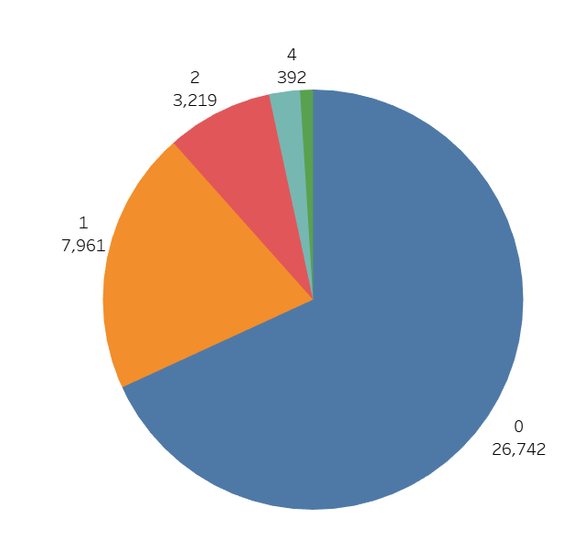
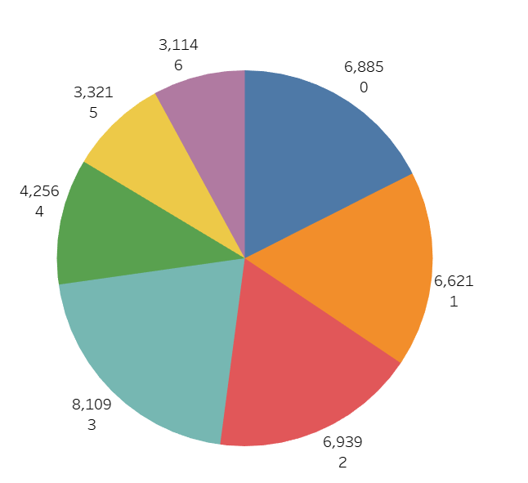
Number of Violations/Accidents
Number of Accidents
Number of violations

Slide 19
Conclusions:
Gender ×
Higher loss ratio groups: Vehicle use for leisure purpose primarily; divorced people and those at the age of 50-70
Total premium VS. number of accidents/violations √
Claim amount VS. number of accidents/violations ×
Most insurances are sold to those with low accidents/violations cases

Slide 20
Recommendations:
Charge more premium on insurers whose primary vehicle use are for leisure , who are divorced, whose age is within 50-70
Charging higher premium-cost and benefit analysis
Increase sales among drivers with high number of accidents/violations
Sell more expensive insurance to drivers with high number of accidents/violations, and sell cheaper insurance to drivers with lower number of accidents/violations

Slide 21
Location Dimension
Local age group
Gender
Primary use
Vehicle price
Number of violation

Slide 22
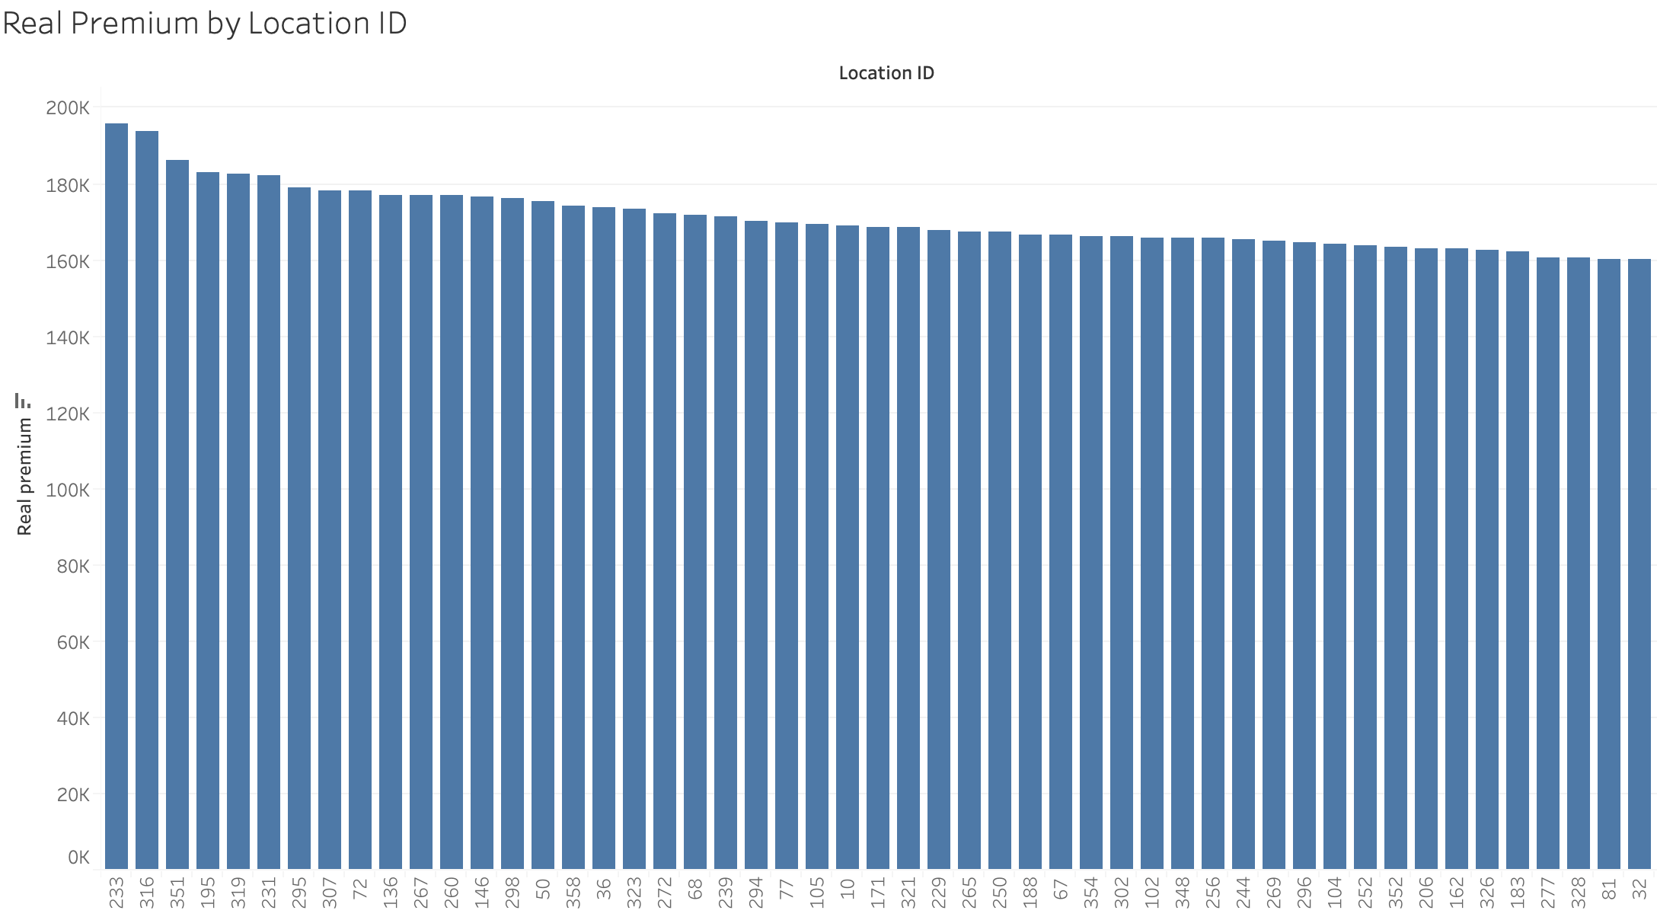
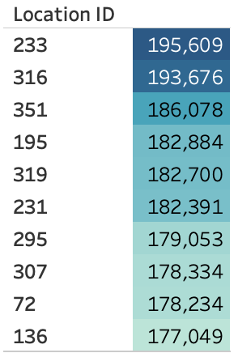

Premium

Slide 23

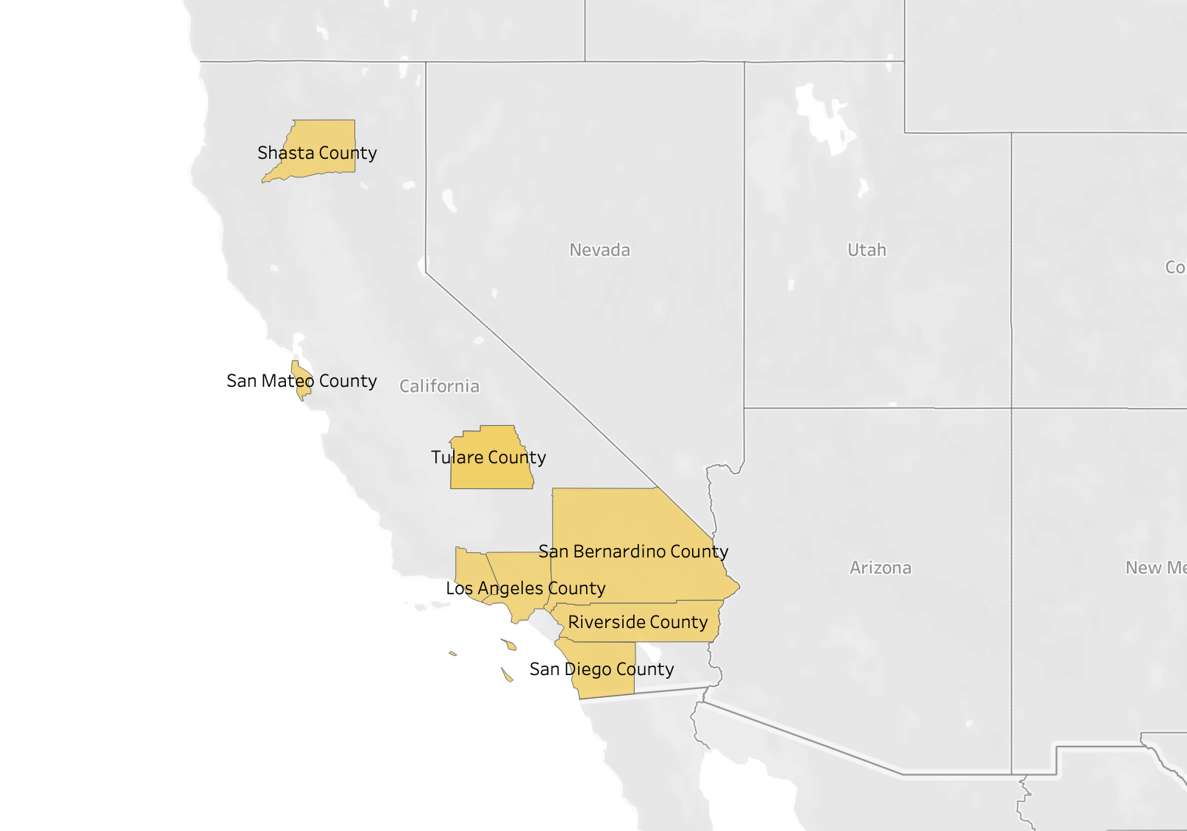
South California has higher premium

Slide 24
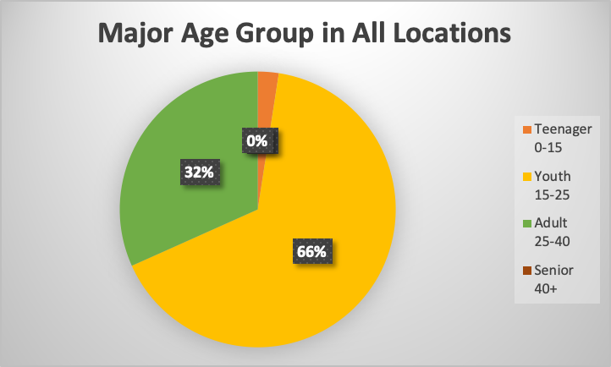
Does it relates to population age?
Safe Assumption:
The age group which has the largest percentage is the major age group in the local area.
We excluded 41 locations which have more than two major age groups.

Slide 25
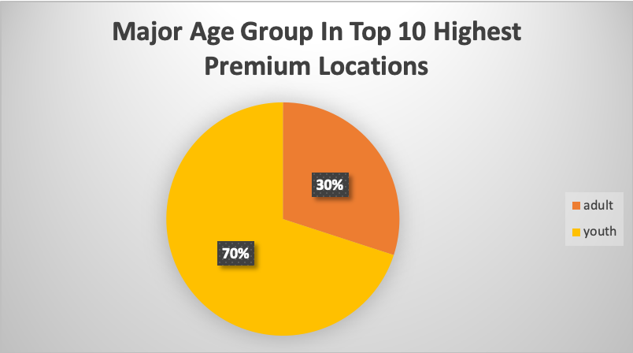
Locations resident by more younger people have the higher premium

Slide 26
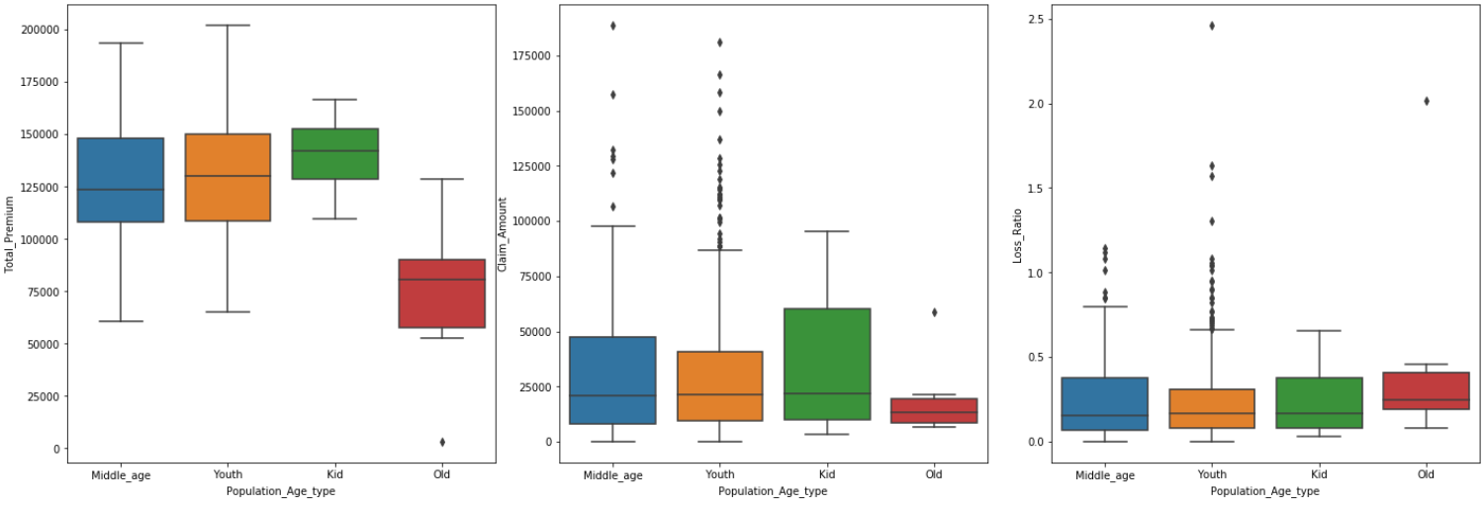

Slide 27
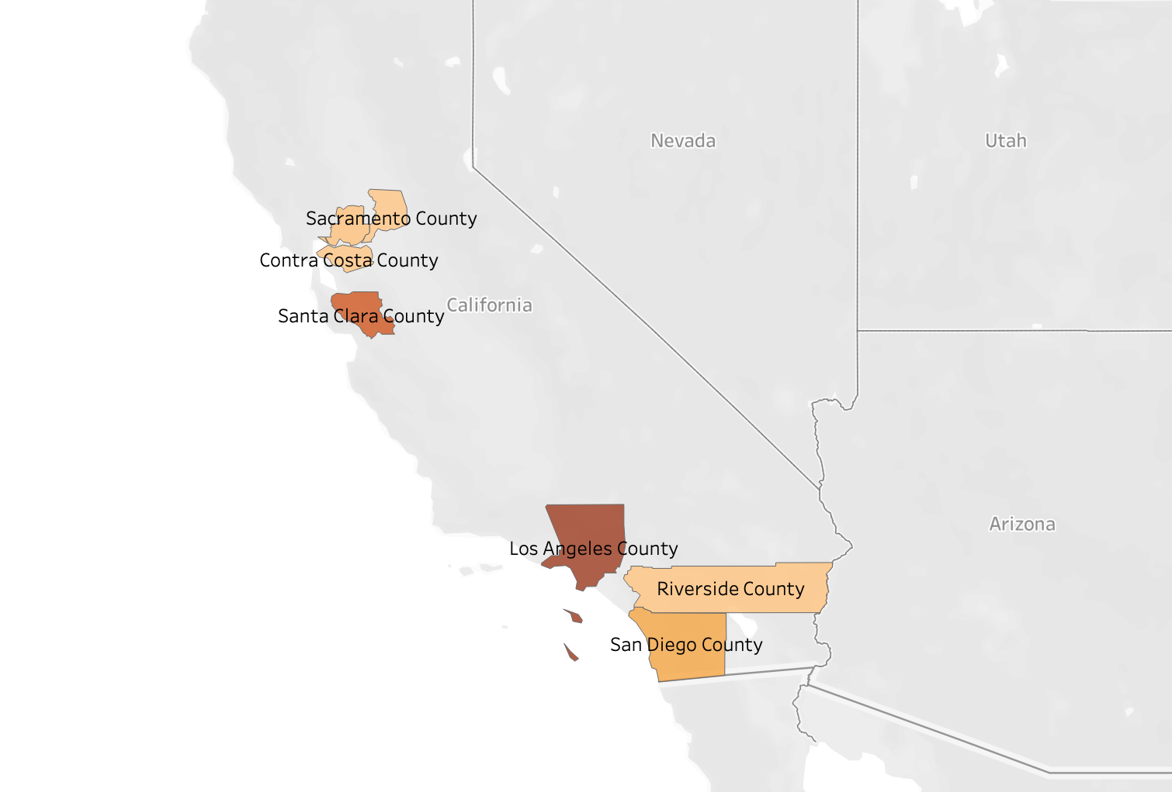
Loss Ratio
Bay Area
LA
SD
Top 10 highest loss ratio area

Slide 28
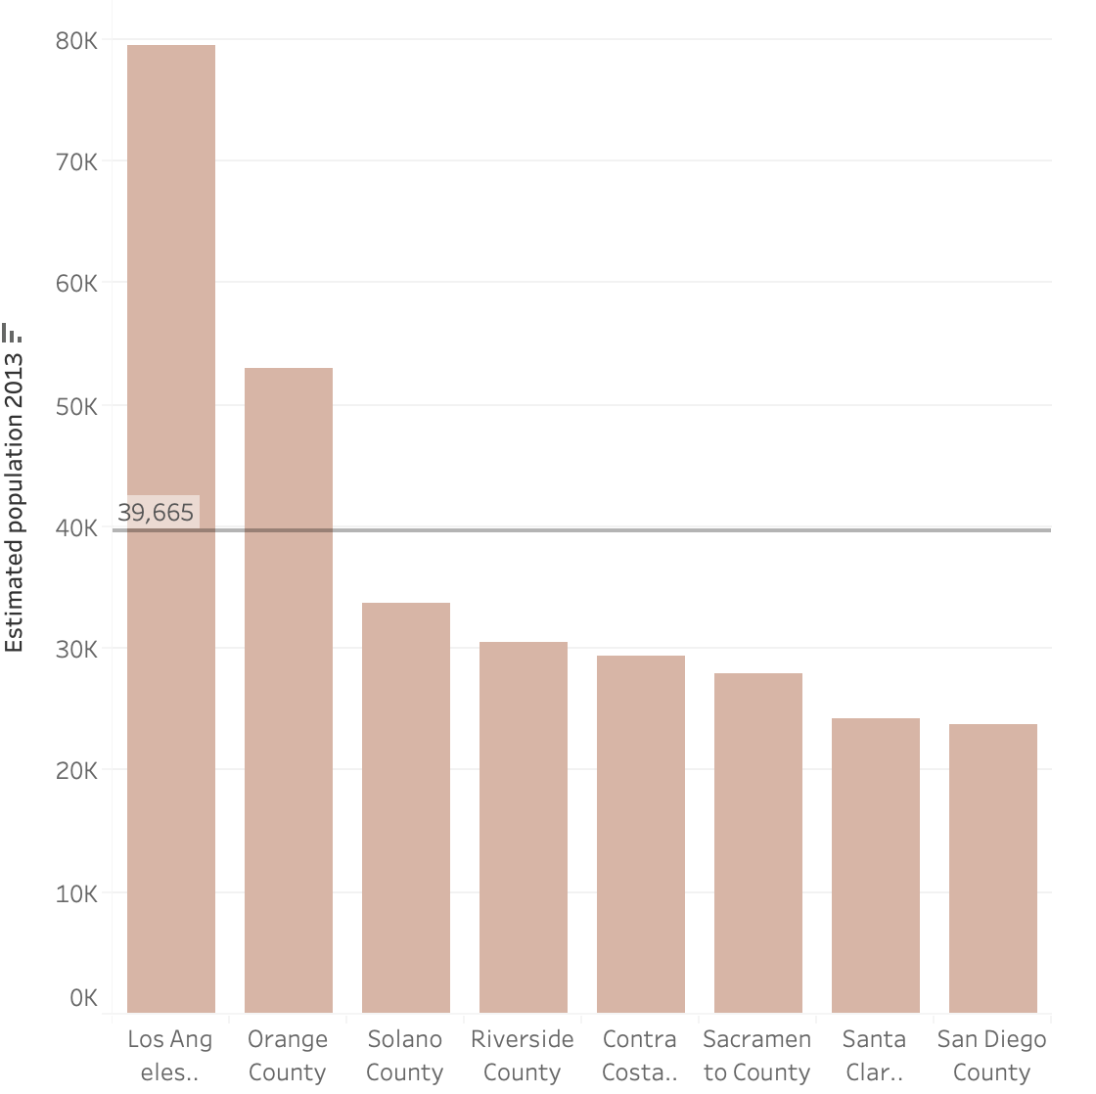

WHY----Large population?

Slide 29
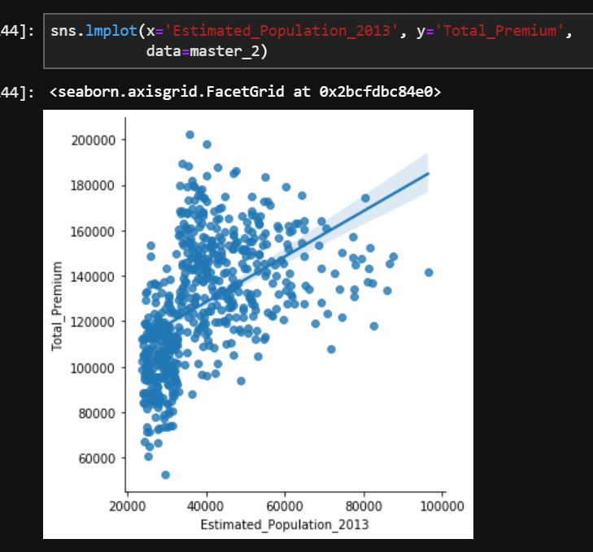
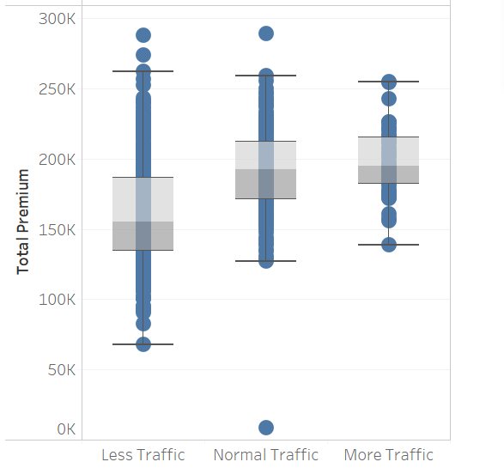
Positive correlation between premium and population
Invest greater selling effort in populationally condensed area
Notes:
是否需要具体的回归数据？

Slide 30
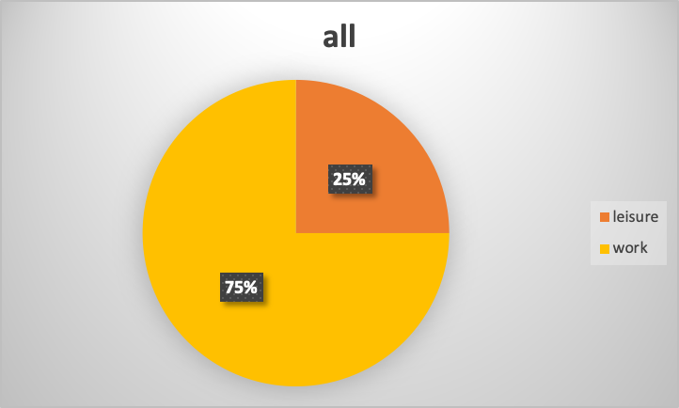
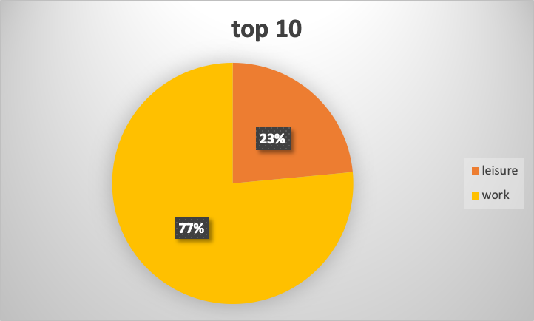
Primary use?

Slide 31
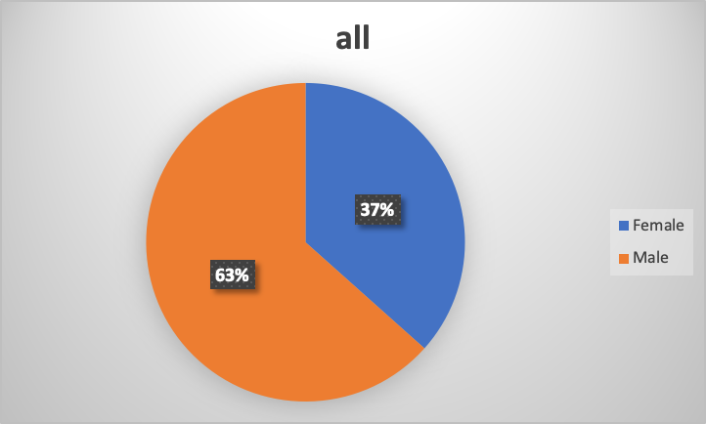
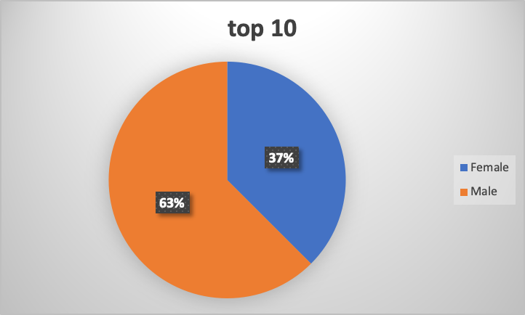
Gender?

Slide 32
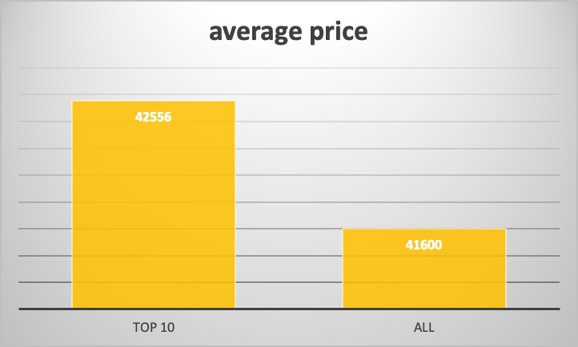
Vehicle Price!
Charge higher premium for expensive vehicles

Slide 33
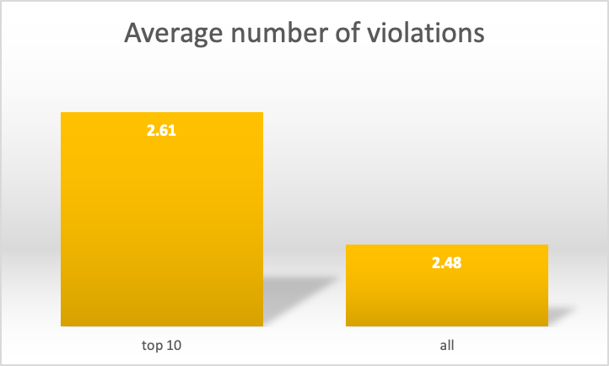
Number of Violations!
Charge higher premium for drivers who have more violations before

Slide 34
Wrap Up & Recommendations
What we found:
South California has higher premium
Locations resident by more younger people have the higher premium
Bay area and greater Los Angeles have higher loss ratio
What we suggest:
Premium in Bay area should be set higher
Invest greater selling effort in populationally condensed area
Charge higher premium for expensive vehicles
Charge higher premium for drivers who had more violations before

Slide 35
Policy Dimension
Canceled Policy
Claim Description
Effective Date
Agency/Underwriting Companies

Slide 36


Cancelled Policy
Loss Ratio
31%
Cancelled policy
6,040
Loss Ratio
18%
Completed policy
33,154

Slide 37
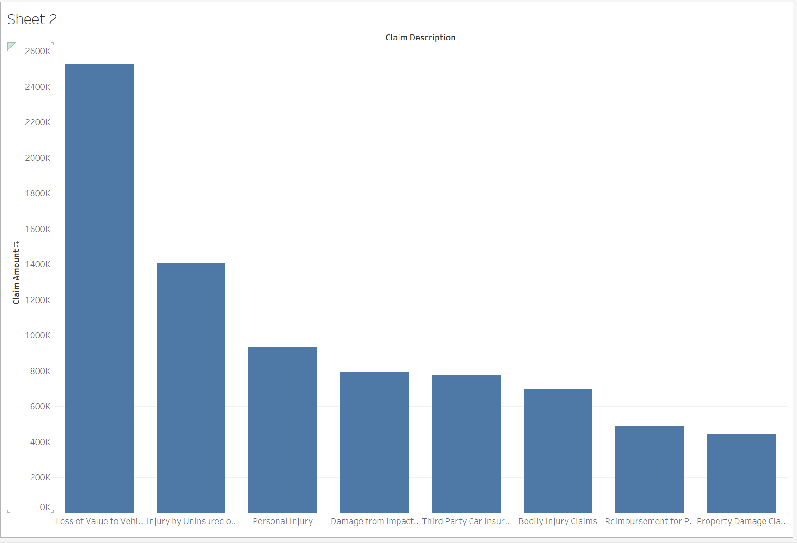
By analyzing the reasons why claims are paid, we found the reason with highest claim amount is ‘loss value to vehicle’, and the second highest is ‘Injury by Uninsured or Underinsured Defendant’.

Slide 38
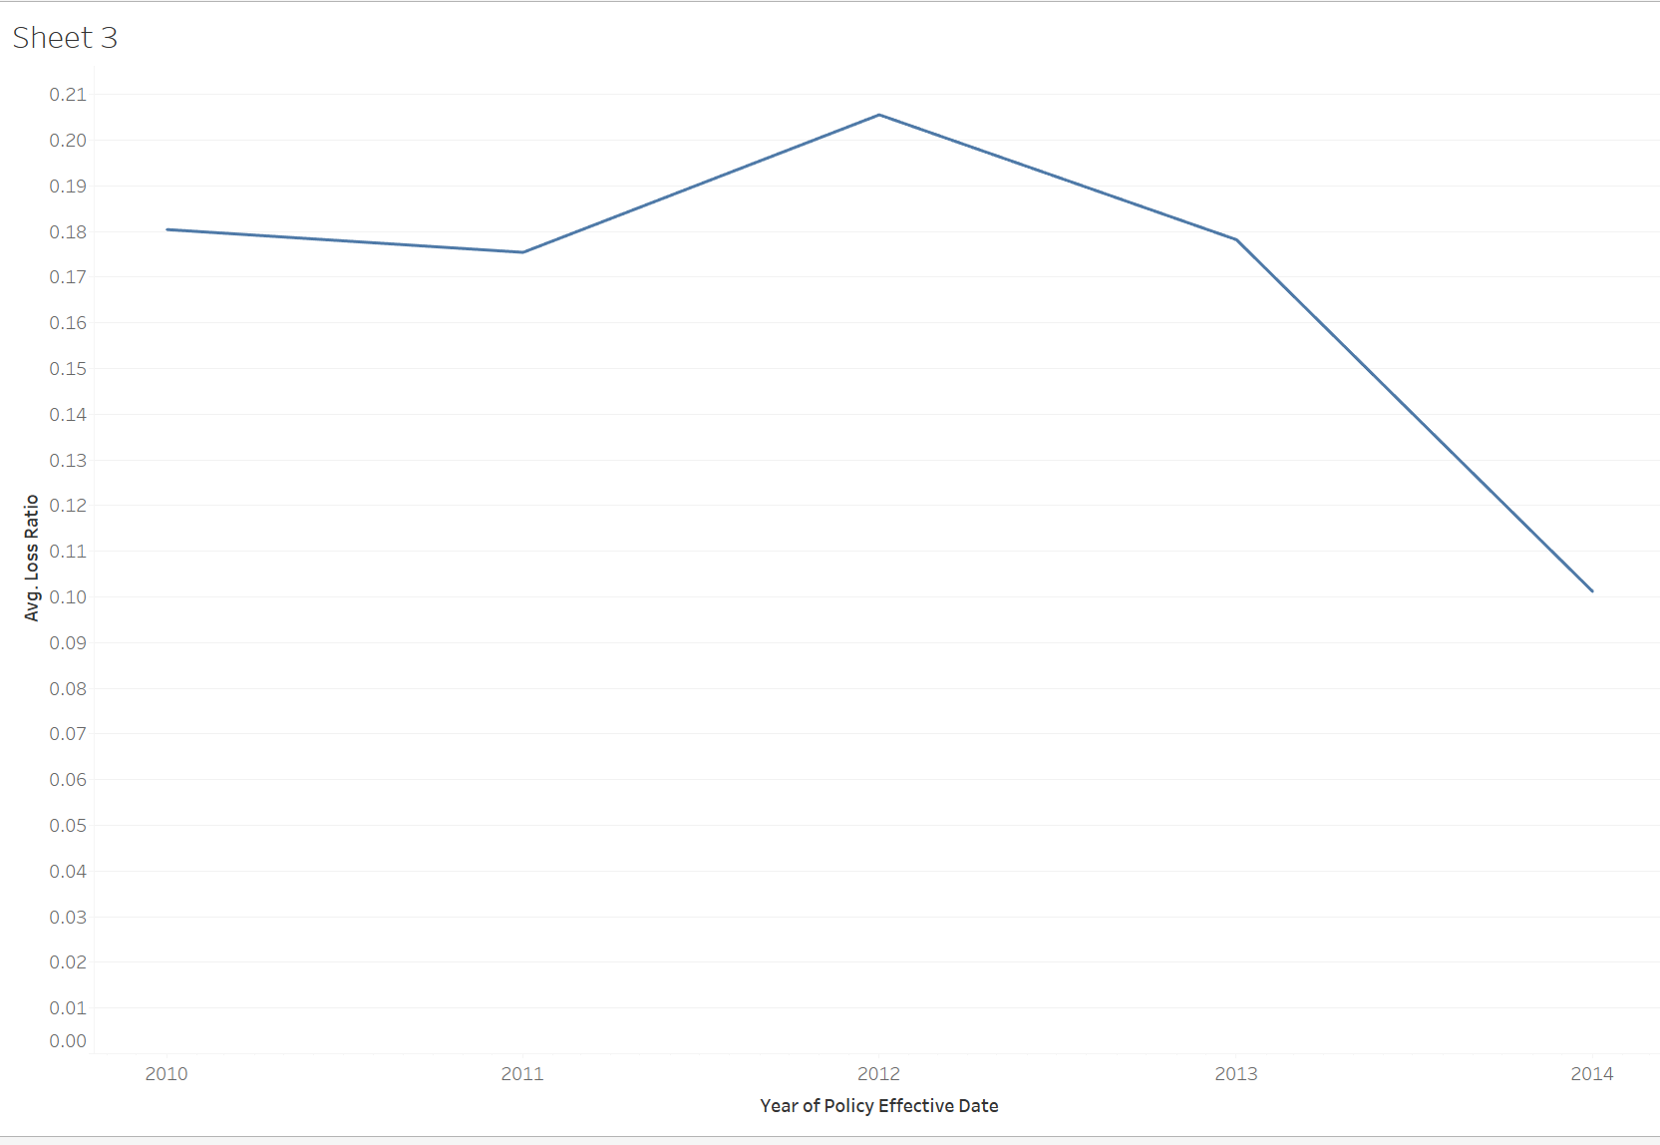
Timeline
After calculating the average loss ratio in each year when the policies started to be effective, we found that the policies sold in 2012 show a much higher loss ratio than policies in other years.

Slide 39
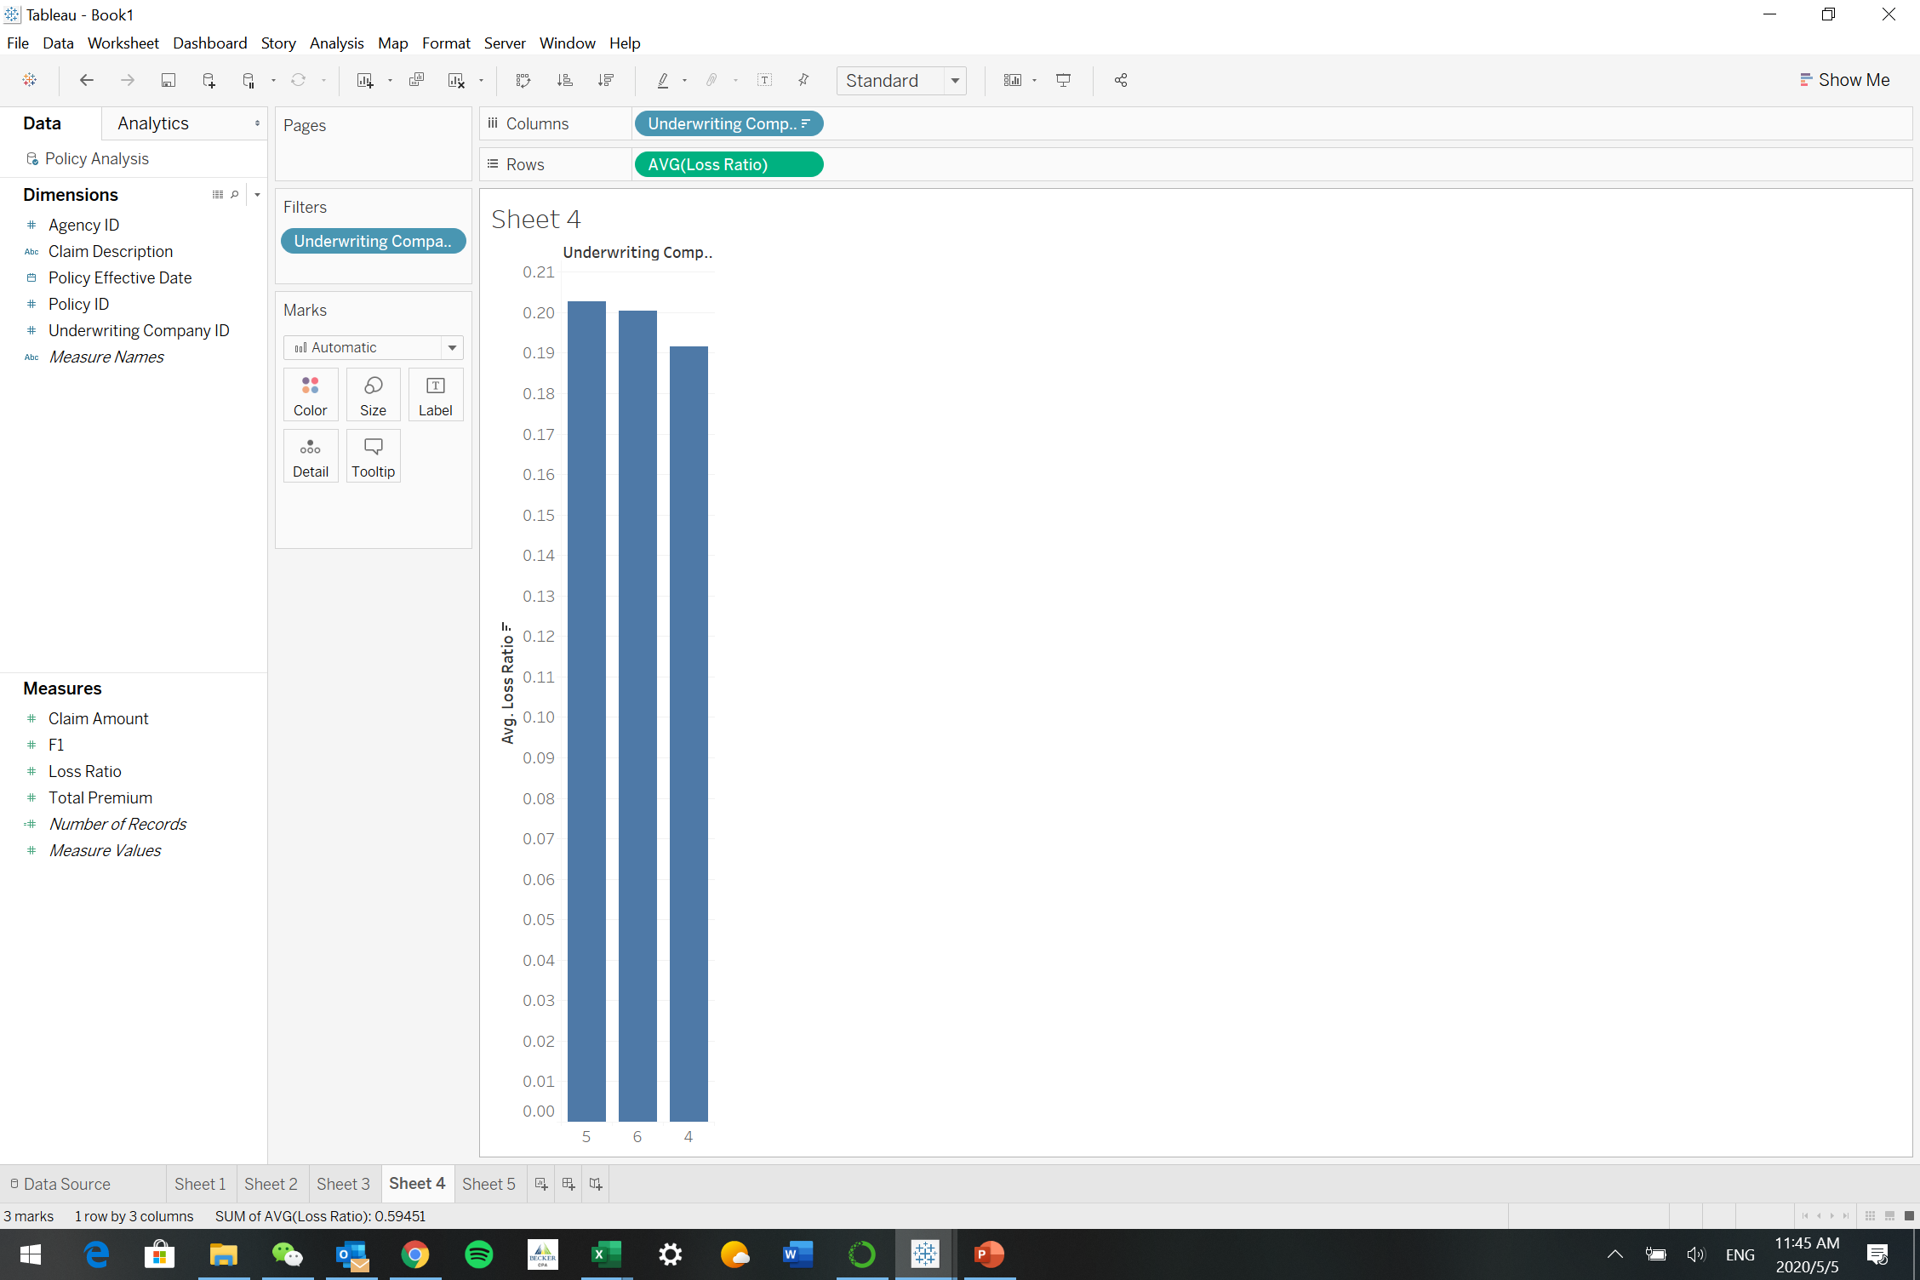
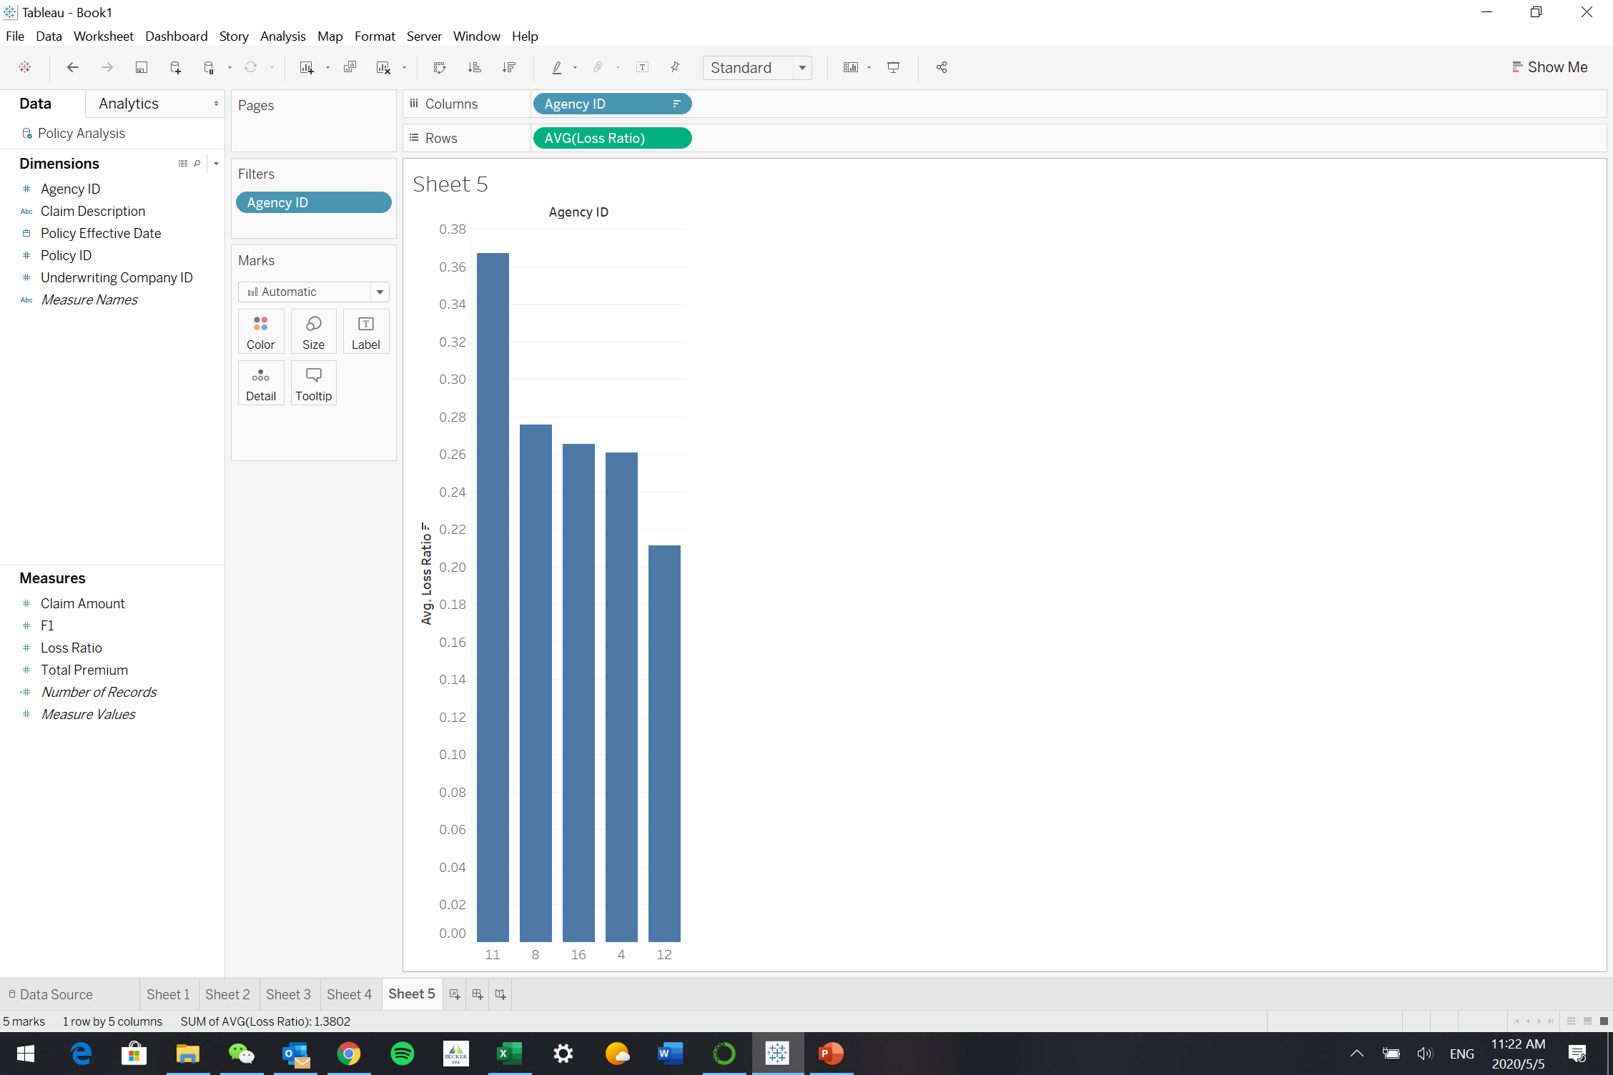
Agency/Underwriting Company
The agencies with top five high loss ratio are Yugine C Sport Insurance, Kostyo Insurance Agency, Garys Insurance Agency, California Automobile Insurance and Alandale Car Insurance.
The underwriting companies with top three loss ratio are Mercury CA Insurance, Clovis Insurance Agency and California Automobile Insurance.

Slide 40
Recommendations:
Avoid policies being canceled and charge a fee on canceled policies to compensate loss;
Charge a higher premiums to the vehicles that tend to have a high possibility to have a value loss in the future;
Replace the agencies and underwriting companies with high loss ratio with better performing companies;

Slide 41
Summary
This company is not underperforming.

Slide 42
Recommendations
Premium-pricing:
Charge higher premium
for expensive vehicles
for vehicles with higher potential of losing value
for drivers who had more violations before, and lower premium for driver without accidents and violations records before
In Bay area should be set higher
when faced with high-loss-ratio car makers.
for insurers whose primary vehicle use are for leisure , who are divorced, whose age is within 50-70.
Marketing Strategy:
Invest greater selling effort in populationally condensed area
Promote sales on drivers with higher number of accidents

